Slide 1



OpenHeart
125
Providing Transparency And Accessibility To San Diego
Progressive web application with an emphasis on accessibility that facilitates price comparisons of medication and medical services to the people of San Diego. Additionally allowing providers to find new health trends, so that they are better equipped to handle them.
Mobile
User Experience
Intended use for everyone, but an emphasis put on the bilingual nature of the application and its ease of use.
Data comes primarily from scraping websites, but in the future partnerships are strongly sought after to provide the prince information, in exchange for information on trends.
Notes:
David

Slide 2
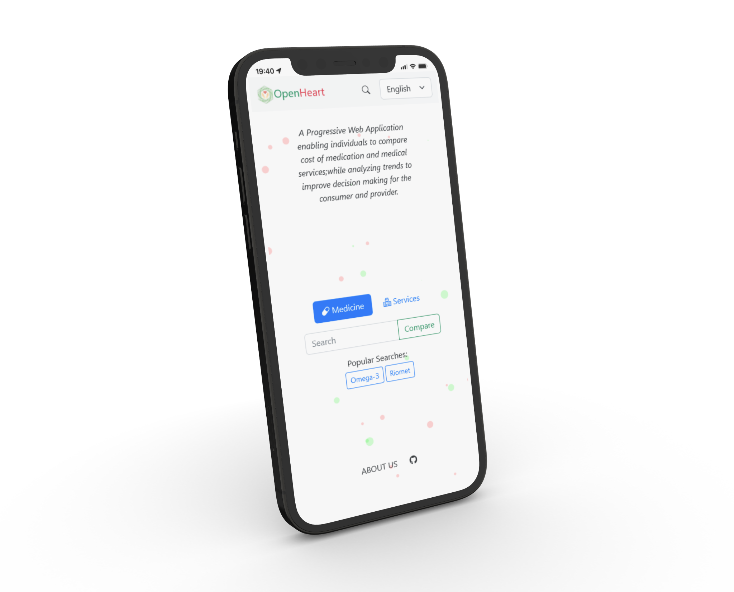

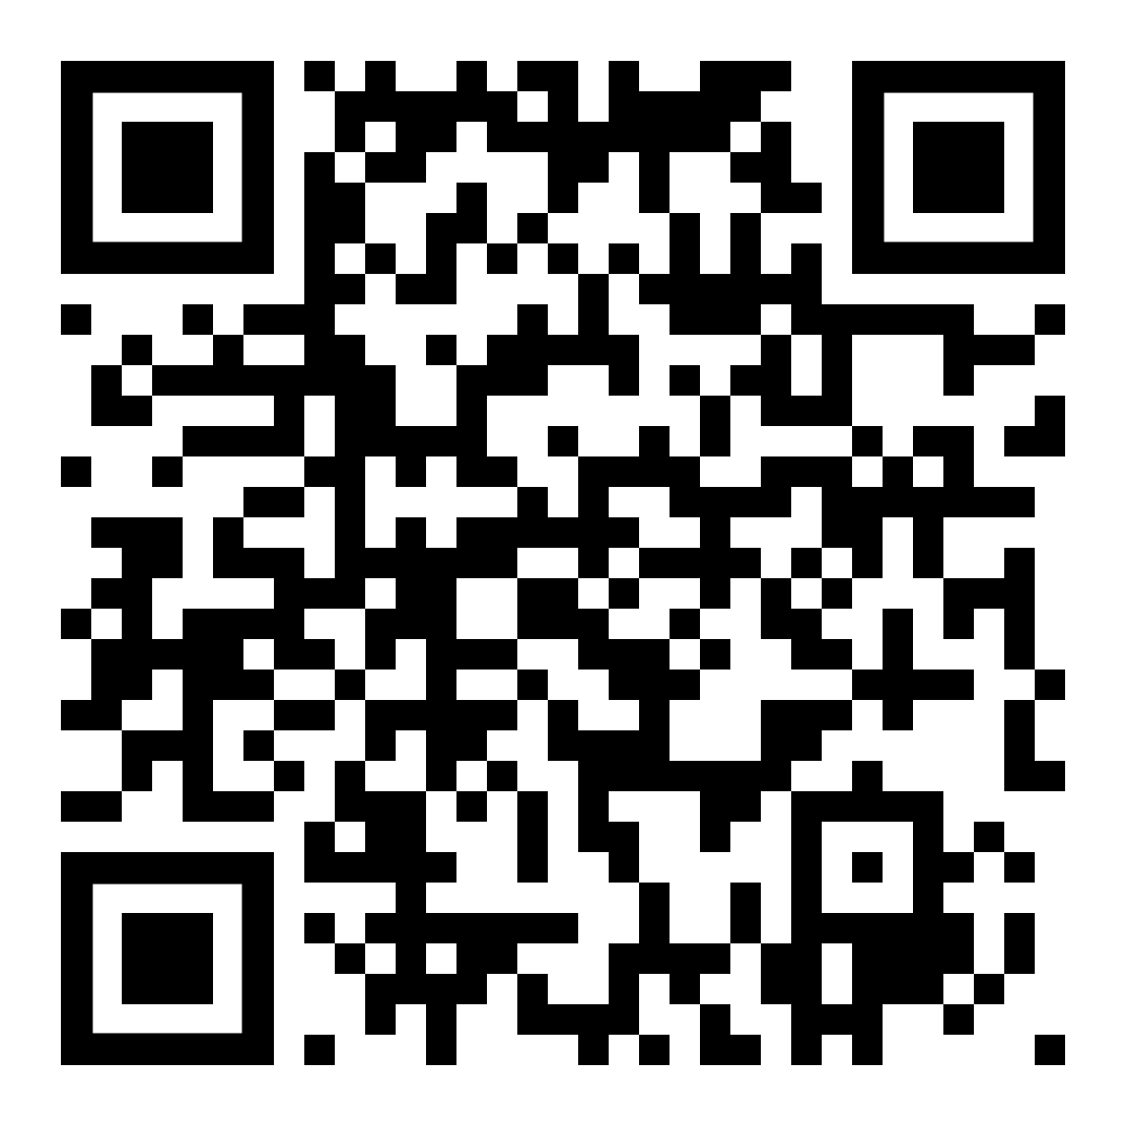
Product: OpenHeart
125
VIDEO

